Slide 1
Year 6 Topic Overview
Spring Term 2022

Slide 2
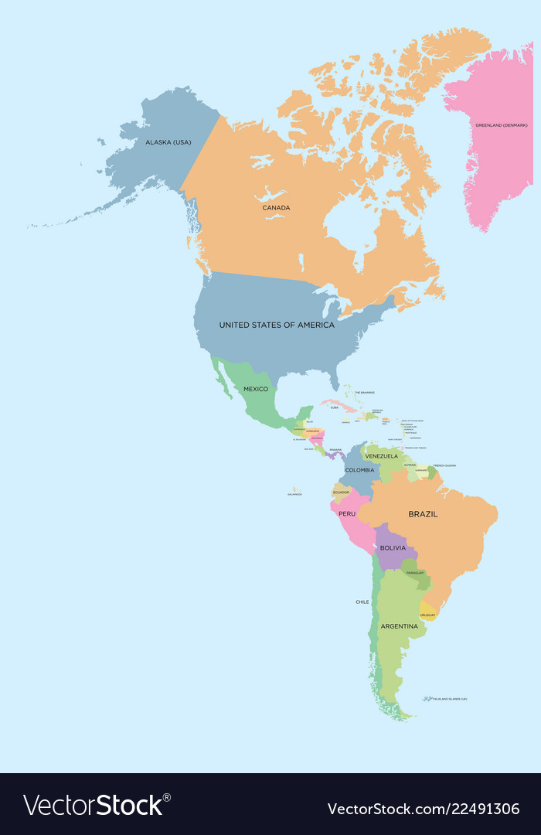
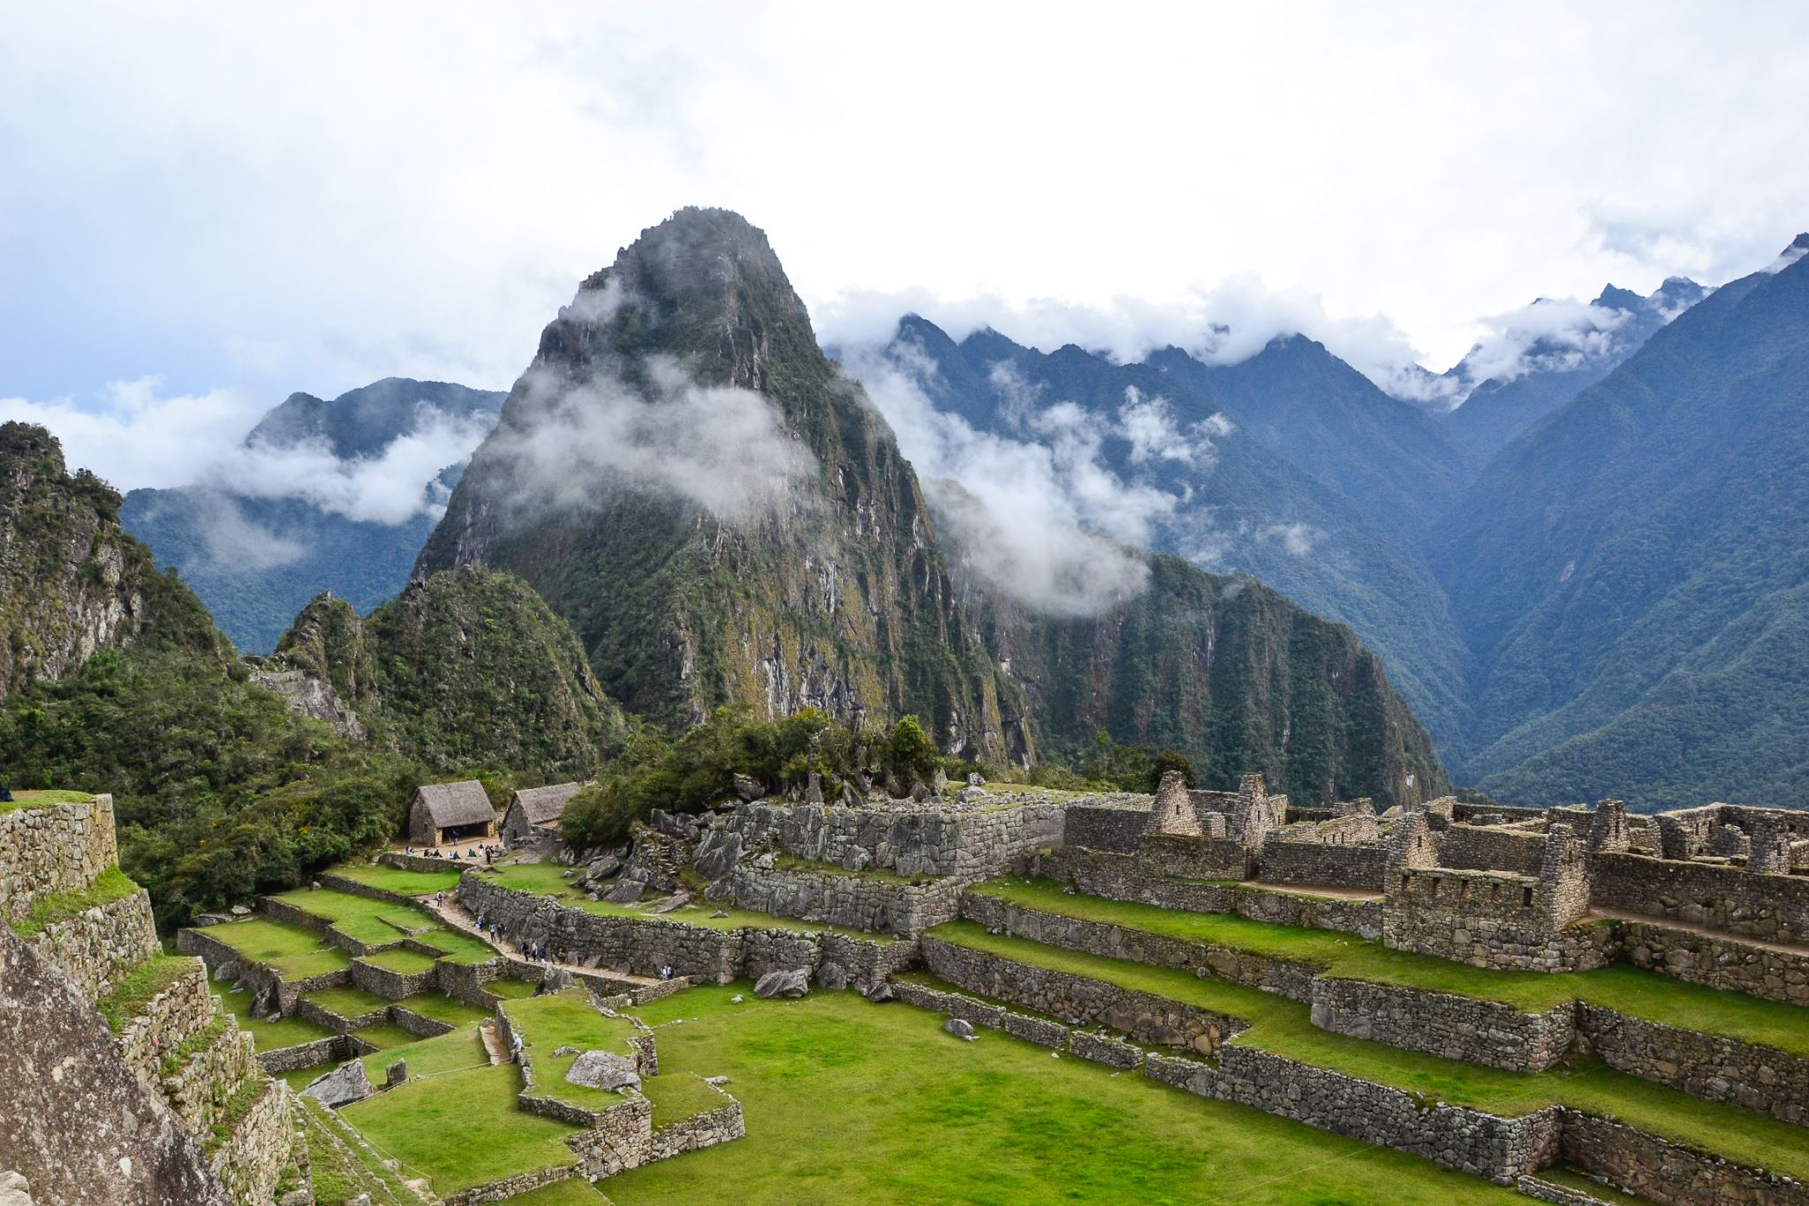
Year 6 ‘Road Trip Americas’
Geography
Our key topic driver this term is Geography.
The children will learn about the physical and human geography of North and South America focusing on the similarities and differences of these places with each other and to Europe and Hull.

Slide 3
Year 6 ‘Road Trip Americas’
Science
In science, the children will focus their learning on ‘Animals Including Humans’ and ‘Living Things and their Habitats’. They will explore how the main parts of the human circulatory system, as well as how nutrients and water are transported. They will also look at characteristics of animals and use these to classify them as well as learning about microorganisms.
PSHE
In PSHE, the children will be focusing on celebrating differences in cultures, beliefs and lifestyles and they will also be discussing their dreams and how to set achievable goals.
Religious Education
In RE, children will explore learning questions linked to the Christianity and focus on the Christian understanding of eternity and the Christian belief that God’s love for humankind is eternal. They will then draw on all their knowledge and understanding of Christianity to decide whether Christianity is still as strong a religion as it was 2,000 years ago.

Slide 4
Year 6 ‘Road Trip Americas’
Design and Technology
In Design and Technology, the children will develop their sewing skills to make a drawstring that they can take on holiday. They will be supported by a local Hull designer in the design stage of the process!
Art
In art, children will focus on their painting and collaging skills. they will draw on inspiration from the artwork of Brazilian artist Beatriz Milhazes to create their own collaborative art work and will then create a landscape painting inspired by female artists Okeefe and Adam.
Music
Children will continue to develop their skills by listening and appraising a range of music.

Slide 5
Year 6 Core Subjects
Maths
Children will cover a range of objectives in the following topics: Decimals, Percentages, Algebra, Converting Units, Perimeter, Area & Volume and Ratio. Objectives include multiplying and dividing by 10, 100 & 1,000 as well as multiplying and dividing decimals by integers. Children will also learn to identify equivalent fractions, decimals and percentages as well as find percentages of amounts.
Writing
Children will explore quality picture books such as ‘The Water Tower’ and ‘The Island’ and use these as stimuli to write a thriller narrative and a journalistic piece. They will create a setting description, using ‘Jumanji’ as their hook. They will continue to consolidate and expand their knowledge of KS2 grammar.
Reading
Children will receive daily guided sessions and will focus on expanding their knowledge of vocabulary as well as their retrieval and inference skills by exploring different sections of text from the book ‘The Many Worlds of Albie Bright’. They will also develop these skills across a range of non-fiction texts.

Slide 6
Year 6 Supporting your child at home
Reading
Encourage your child to read everyday. Where possible, ask your child about unfamiliar vocabulary or events of the story.
Maths
Daily sessions on TT Rock Stars
Consolidate skills us formal written methods for four operations
SATs Preparation
SATs guides are still available to purchase.
Writing
Encourage your child to practise their spellings weekly.

